Slide 1

D
Exploring Risk Factors Associated with Diabetes
By Sandeep Bansal

Slide 2
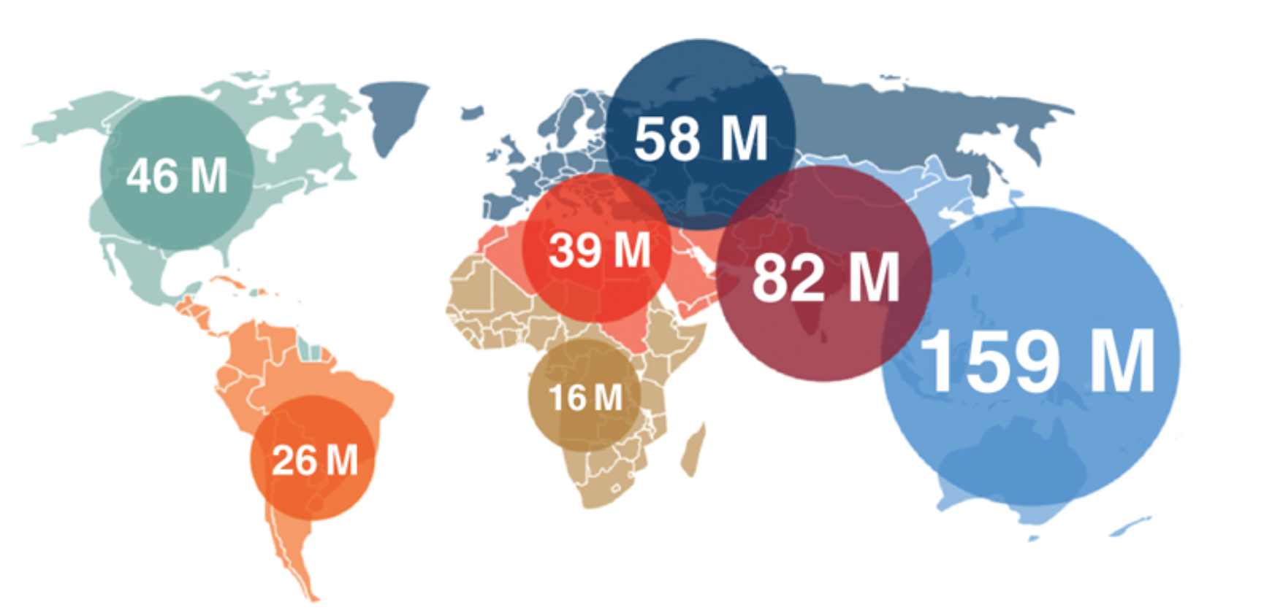
Research Question & Motivation Can a machine learning model accurately predict whether or not patients have Diabetes?

Slide 3
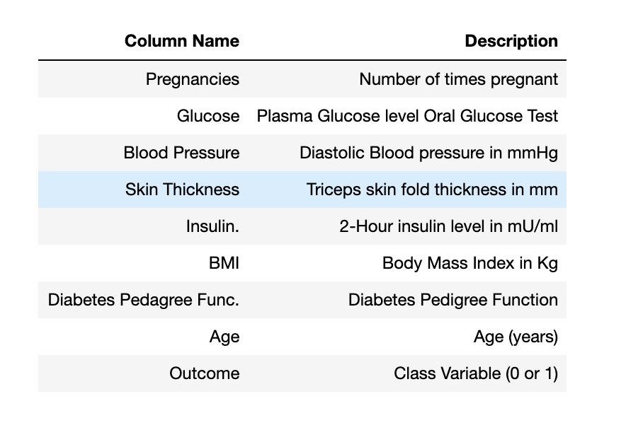
Dataset
Source: Kaggle open source
Shape: (768, 9)
Notes:
This dataset is originally from the National Institute of Diabetes and Digestive and Kidney Diseases. The objective of the dataset is to diagnostically predict whether or not a patient has diabetes, based on certain diagnostic measurements included in the dataset. Several constraints were placed on the selection of these instances from a larger database. In particular, all patients here are females at least 21 years old of Pima Indian heritage.
Content
The datasets consists of several medical predictor variables and one target variable, Outcome. Predictor variables includes the number of pregnancies the patient has had, their BMI, insulin level, age, and so on.
Acknowledgements
Smith, J.W., Everhart, J.E., Dickson, W.C., Knowler, W.C., & Johannes, R.S. (1988). Using the ADAP learning algorithm to forecast the onset of diabetes mellitus. In Proceedings of the Symposium on Computer Applications and Medical Care (pp. 261--265). IEEE Computer Society Press.
Inspiration
Can you build a machine learning model to accurately predict whether or not the patients in the dataset have diabetes or not?

Slide 4
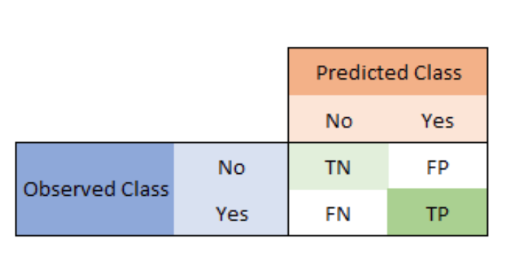
Methodology and Approach:
Logistic Regression
Calculates the probability that a given value belongs to a specific class.
Model Metrics:
Accuracy
Precision
F1_Score
Recall

Slide 5
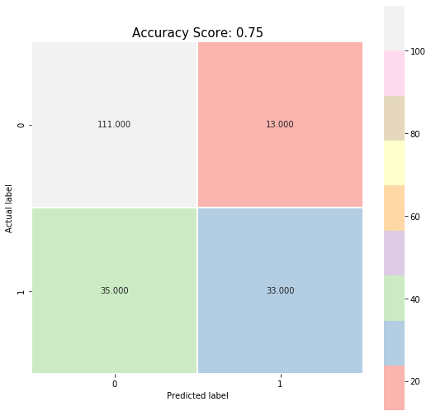
Results and Findings
Model | Evaluation
Accuracy | 0.75
Precision | 0.89
F1_Score | 0.82
Recall | 0.76

Slide 6
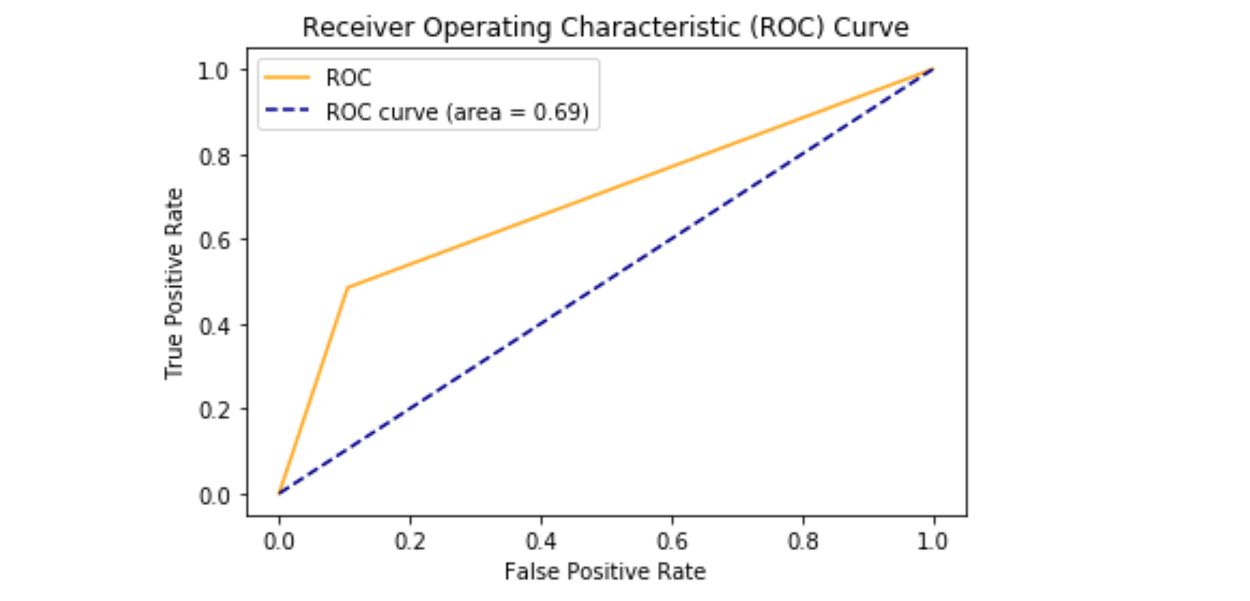
Results and Findings

Slide 7
Thank you!

